Slide 1
DRAGONBALL SWITCH
Tomas Brazas
&
Jake Warren
Group Project

Slide 2
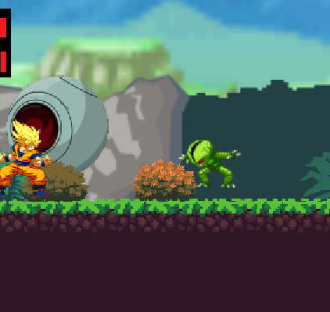
Introduction
A single-player 2d side-scroller action adventure platformer game
Inspired by DragonBall Z
Unity Engine

Slide 3

Why Unity?
Successful development engine
Award winning games
Easy to learn
C# Language
Much support available online

Slide 4

Other Technologies
GitHub
GitHub Desktop
Audacity
Visual Studio 2017
Main IDE (integrated development environment)
Adobe Photoshop

Slide 5
Aims & Objectives
Develop a DragonBall Z game that has a unique feature
Further Unity knowledge
Improve teamwork/scheduling skills
To incorporate our hobbies in the project

Slide 6
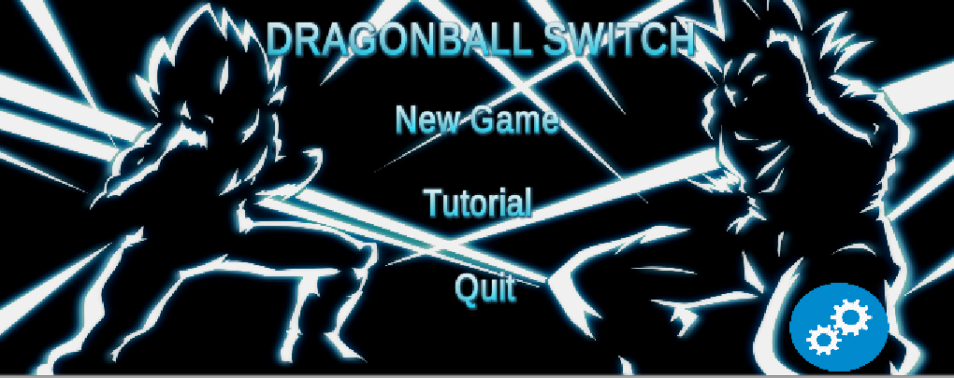
Architecture of the solution
Movement
Goku
Vegeta
Sprites
Checkpoints
Animations
Prefabs
Score System
Collectibles

Slide 7
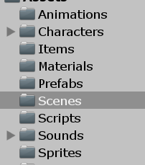
Architecture of the solution
Scenes
Menus
Level
Tilemaps
Sound
Sound Effects
Music
Data Storage
Load/Save progress

Slide 8
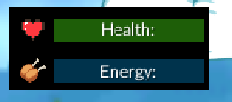
Architectures of solution
Enemy AI
Projectiles
Movement
Resource system
Health system
Energy system

Slide 9
Problems encountered
Player direction switch – Resolved
Enemy AI – Resolved
Player special attack direction and damage – Resolved
Boss AI – Ongoing
Switch script issues - Resolved

Slide 10
Conclusions
Improved collaborating skills
Tackled bugs together
Managed workload
Improved C# coding
Was a fun learning experience
Field of interest
Started with little to no knowledge
Pleased with finished product

Slide 11
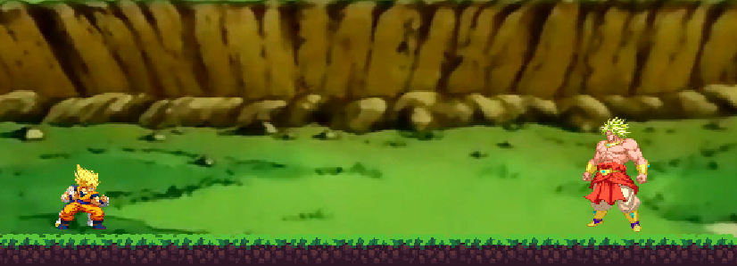
Any Questions?

